Slide 1
Educational System Malpractice and Negligence on the real purpose basis of education
Joshua Corona, Zayrah Nicole Dimarucot
Janine Gallano, Oville Osorio
Darlyn Lilivel E Templanza

Slide 2
Sustainable Development Goals
Goal 4: Quality Education

Slide 3
Starting Salary of the Teacher

Slide 4
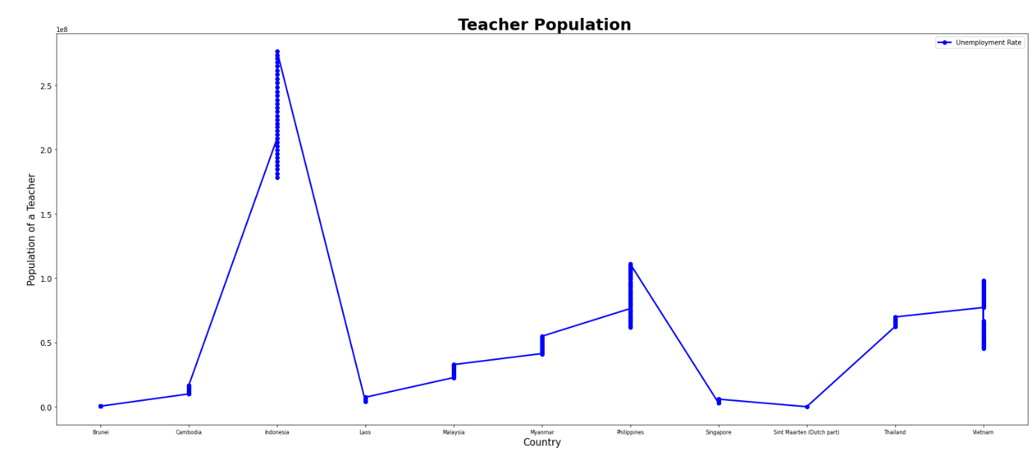

Slide 5
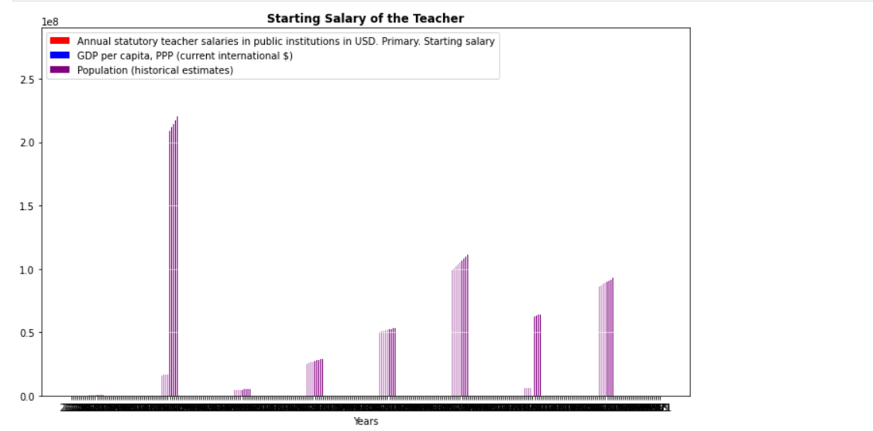

Slide 6
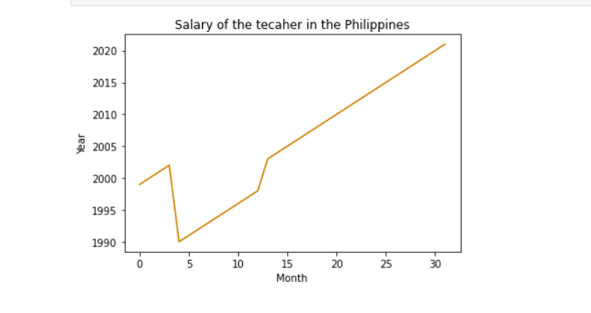

Slide 7
Scheduled time for teaching

Slide 8
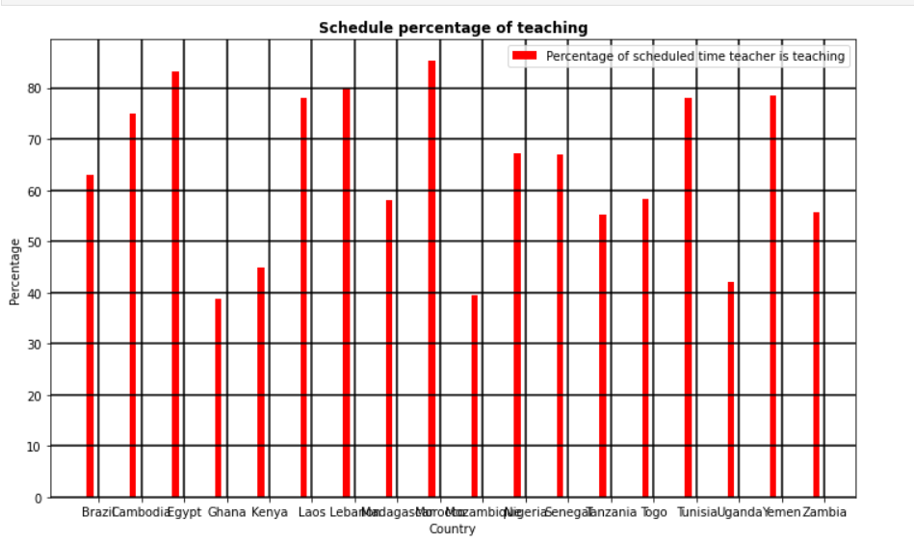

Slide 9
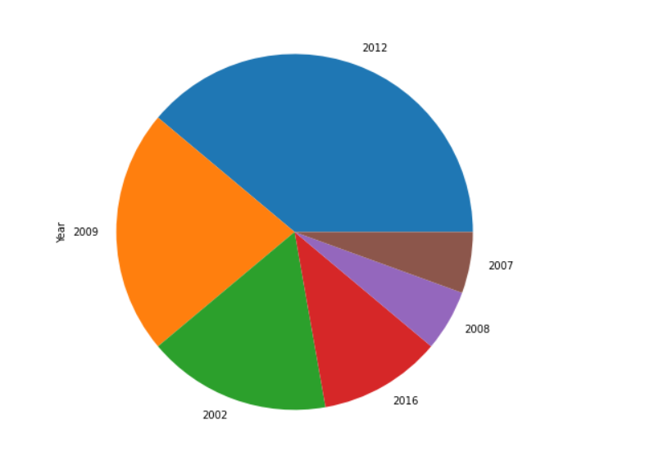

Slide 10
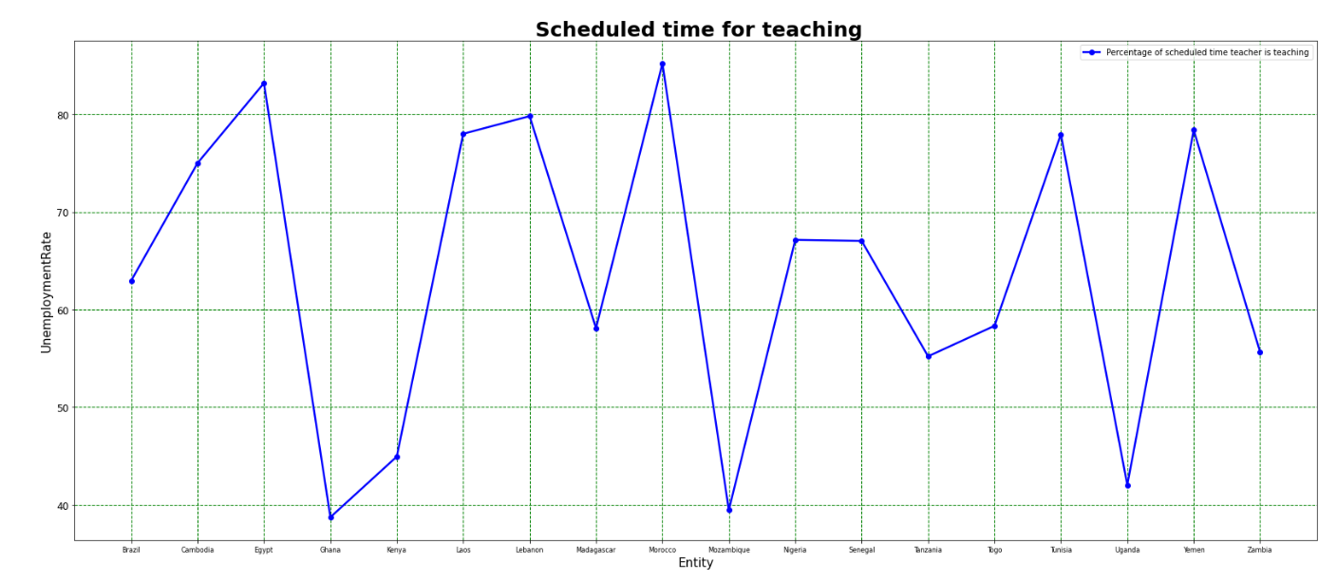

Slide 11
Drop out rate by the population of Male and Female in the Philippines

Slide 12
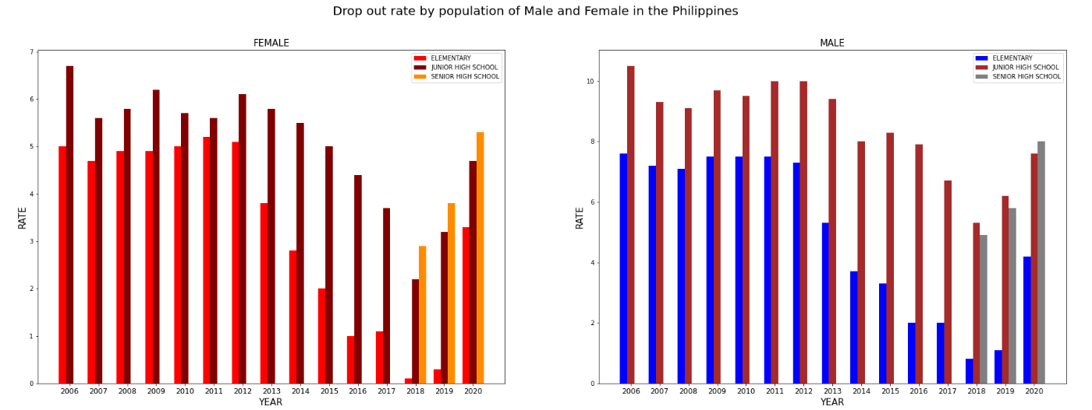

Slide 13
Government expenditure on education, total (% of government expenditure)

Slide 14
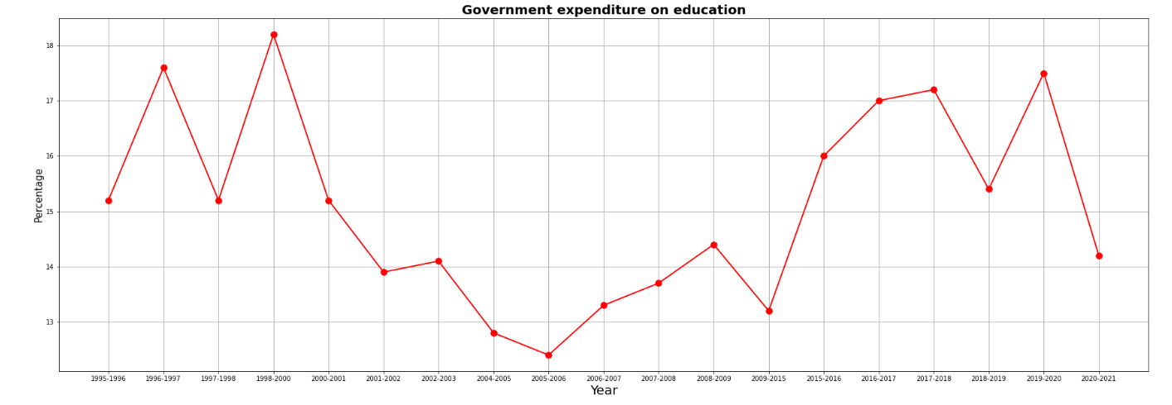

Slide 15
Thank you

